Slide 1
SmartZoo
Controlling & Monitoring system
ECE 186B - Senior Design II
Dr. Shahab Tayeb
Spring 2023
Group members:
Puya Fard, Sahildeep Singh, Dominic Keifer, Rafael Hernandez

Slide 2




Introduction
Introduce team members & roles
Introduce project
Introduce mission statement
Puya Fard Sahildeep Singh Dominic Keifer Rafael Hernandez
Computer Eng. Computer Eng. Computer Eng. Electrical Eng.
Project manager
Hardware configuration
Debugging & testing
Cloud programming
Data server
Communication protocols
Website developer
Software configuration
Debugging & testing
Power analyst
Solar module
Its main objective is to create a safe and smart control environment that assures sensitive animals’ safety in the zoo. This project utilizes embedded
systems, cloud-based programming, and a software-based user interface to monitor, collect, and store data.
Animal groups focused in this project are: stingrays, elephants, and reptiles.
Our mission is to assists zoo workers and the zoo itself by delivering a smart, controlling, and monitoring environment that protects sensitive zoo animals.

Slide 3
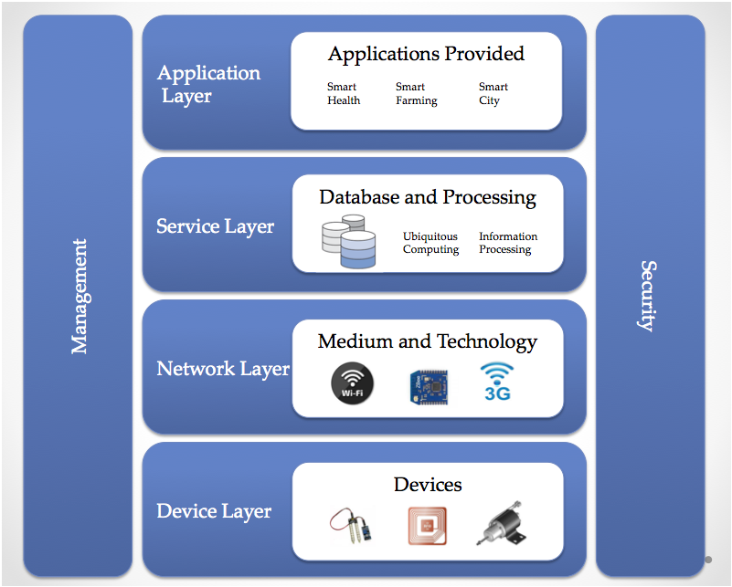
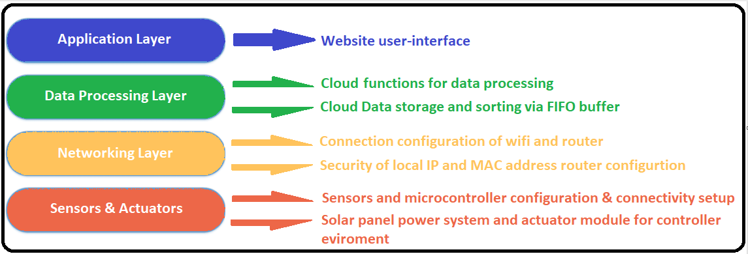
Standards
Introduce our standards
Our Project will be following a general IoT reference model used by many other IoT applications. This contains four standard layers: 1. Application Layer 2. Service Layer 3. Network Layer 4. Device Layer
Fig. 1: IoT reference model
But when it comes to modeling these standards to this project’s specifics, we modified all of the layers according to satisfy project requirements.
Fig. 2: Modified IoT model

Slide 4
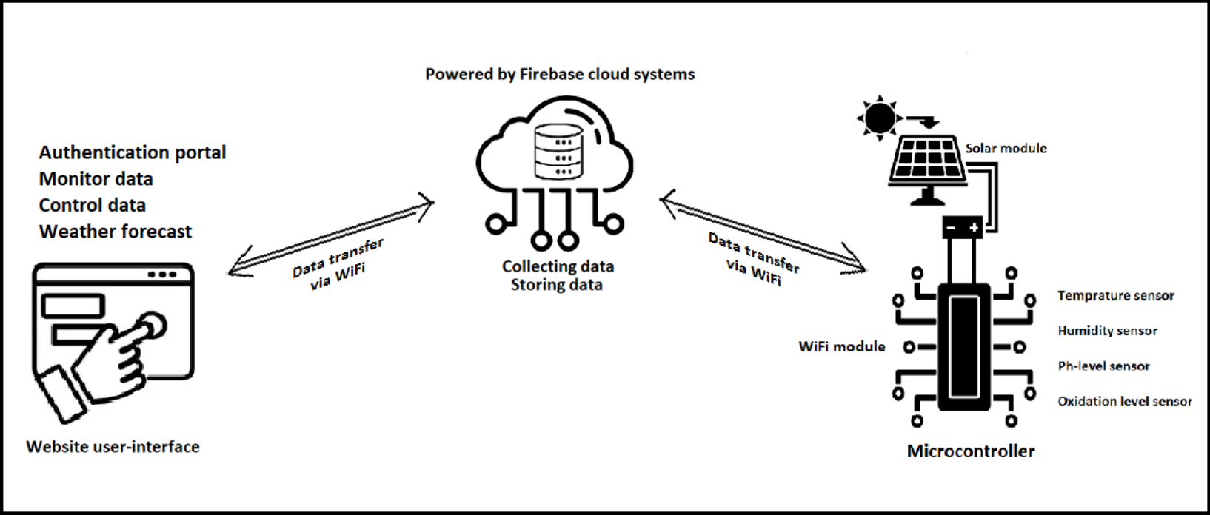
Project Description
The SmartZoo is a project that is going to be a primary control and monitoring system that will have
sensors and nodes connected to its microcontroller end, and user input and application interface to the
Other. And all of these systems will be working and functioning via WiFi and cloud-based programming
and communication. A very basic idea behind our project is modeled in Fig. 3. As we can see we have
three major modules in this project. The software user interface, cloud and data processing, and data
gathering node.
Fig. 3: Basic block diagram

Slide 5
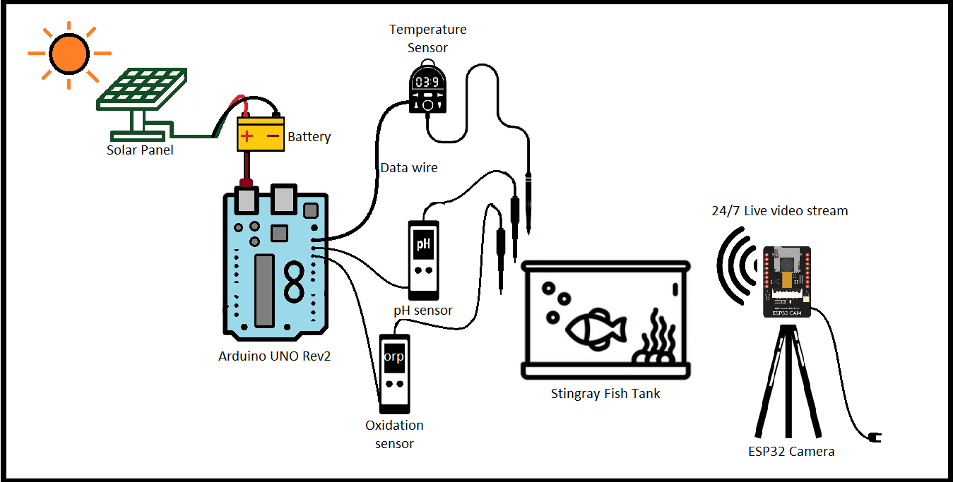
The Stingray Module - Overview
Stingray module physical diagram is created to visualize how our physical components are standing along and within the complete system of sensors and modules. We have a total of 3 input sensors that will be individually configured and connected to our microcontroller. These are the temperature sensor, ph-sensor, oxidation sensor, camera module, and actuator that will be the controlling part.
Microcontroller: Arduino UNO Rev2
Battery: 12V Lead-acid battery
Solar panel: 10W-12V Solar Panel
Temperature sensor: DS18B20 Temperature Probe
pH sensor: pH 0-14 Probe
Oxidation sensor: 51/STM32 ORP Meter Sensor
Camera module: ESP32-Wrover OV2640 Camera module
Fig. 4: Stingray module physical diagram

Slide 6
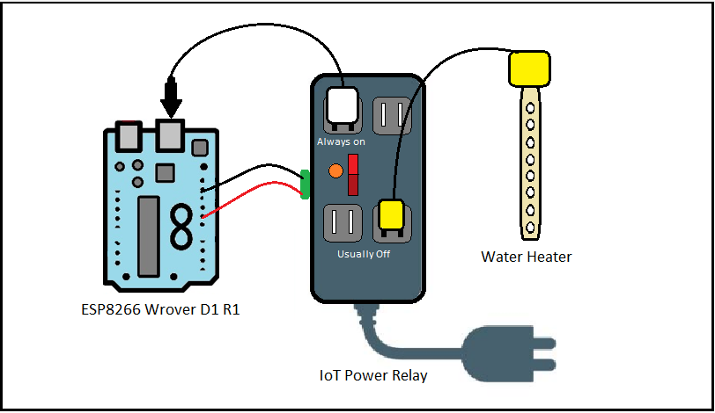
The Stingray Module - Actuator
The figure below demonstrates how the actuator module works. We have a ESP8266 Wrove D1 R1 board connected to a IoT Power relay control pins. The relay has total of four outlets, one of which is always ON. Microcontroller is connected to the Always ON outlet to make sure it is always on and ready to command the relay when relay is connected to the power outlet. We have two water heating probes connected to the controllable outlets of the relay. This way we control switch on/off of the heater via user input through webpage.
Microcontroller: ESP8266 Wrover D1 R1
Power relay: Enclosed high-power power controllable relay
Heaters: 1500W Electric submersible water heater
Fig. 5: Actuator physical diagram

Slide 7
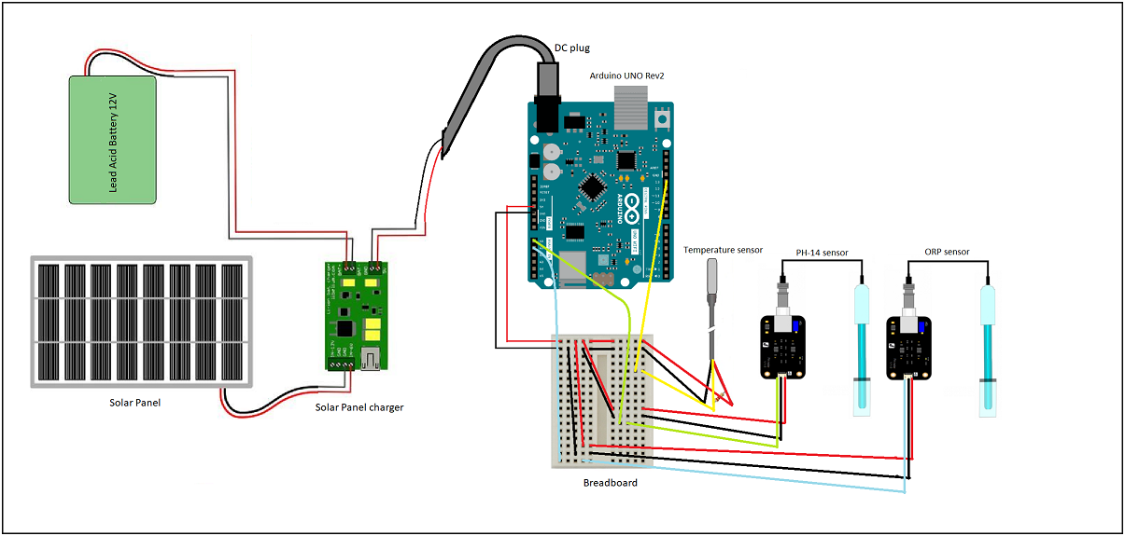
The Stingray Module - Sensor connectivity
The Fig. 6: Arduino and sensors are created to visualize how our system will look when certain sensors and modules are connected to their corresponding pins. We can see that the figure is demonstrating a total of 3 sensor connectivity including a temperature sensor, oxidation module, and ph-sensor probe. These are all connected to a standard 5V power source and GND. Additionally, they have their own specific data pins that require a connection for them to work. Furthermore, we have a solar module connected as well. The solar module includes solar panels and a battery to charge.
Fig. 6: Arduino and sensors

Slide 8
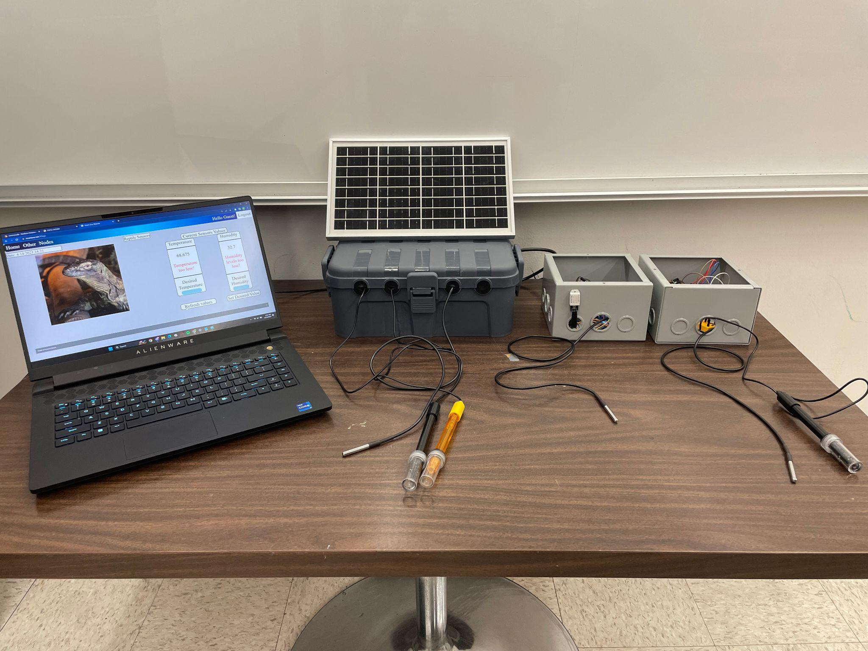

Slide 9
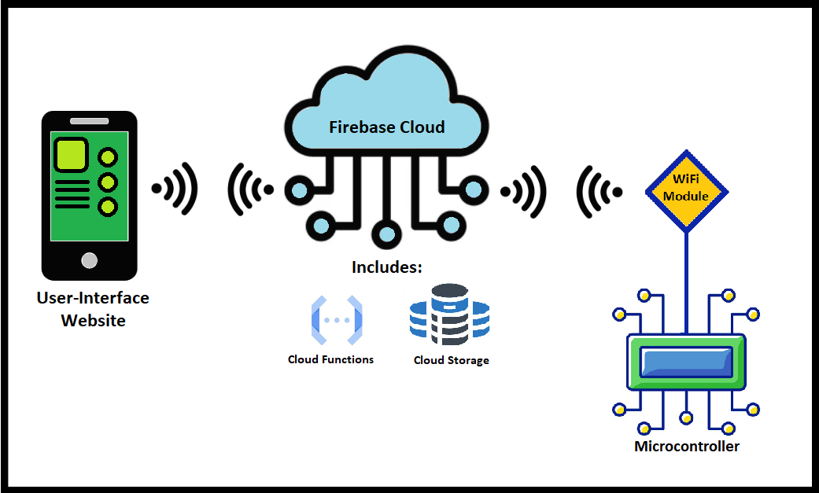
Designing The Cloud
The Fig. 7: Cloud block diagram is provided to help us visualize how the cloud communication system is going to be configured to establish successful data flow between user and node. The cloud is going to store all data collected from our node and sort it in order via the FIFO buffer before transmitting it to our user interface device for monitoring. The user interface will be able to send feedback data which will be stored and transmitted to our node.
Cloud: Firebase powered
Features: Store data & operate data flow via cloud functions
Cloud Functions: functions handle all of the requests/receive data from the sensors. After data is inserted into the database, the cloud functions handle how all the data is stored and shifted inside the database.
Communication: Via WiFi
Fig. 7: Cloud
Notes:
Start reading this after first paragraph.
As we can see in our block diagram, the cloud sits between the user interface and an animal node’s microcontroller
In the cloud for storage we went with the Firebase realtime database which provides us a fast way to read and store data collected by our sensors.
Cloud storage will also be responsible for holding the user input which will be used in the control part of the project which is adjusting the temperature.
Cloud is mostly firebase powered and the features of using firebase is we can manipulate the data using the cloud functions.
Cloud functions will handle all the request for obtaining the data and sorting the data collected in the database
After finishing this, read the bullet points on the right side of image.

Slide 10
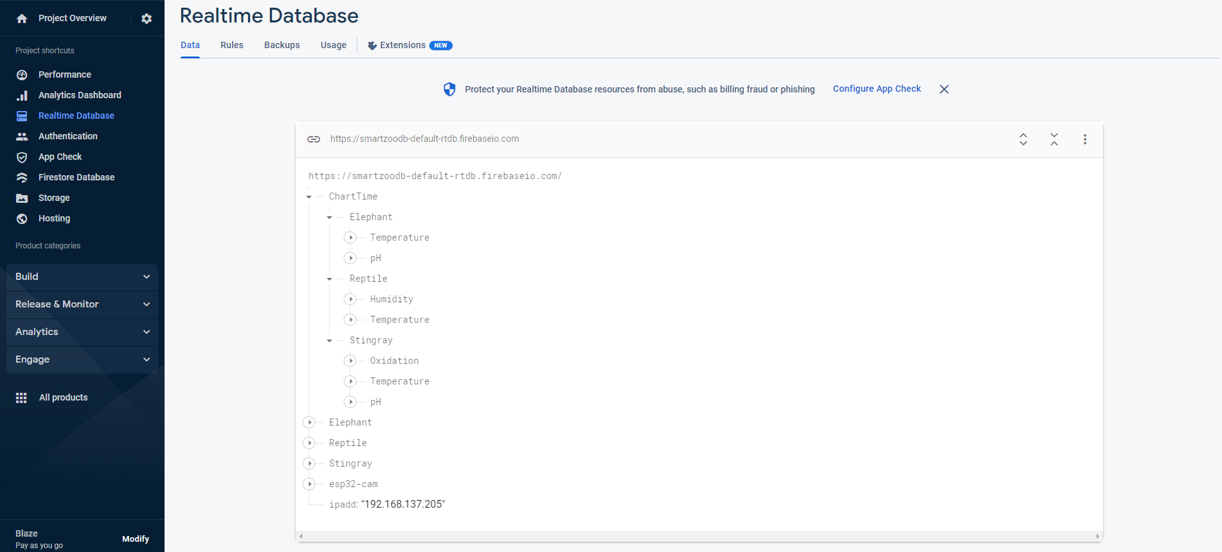
Firebase Realtime Database
In the figure below, Fig. 8. we can see the node called “Chart-Time”. This node stores sensor readings corresponding to the time they were taken. We have 30- minute intervals between collecting data so it is stored in 30-minute intervals at points such as: “1330”,”1400”,”1430”... and so on. This data was ordered like this in the ChartTime node so it can be easily pulled from the website, so we can show that data in a chart which gives users another
way to interpret the data collected by our sensors.
We can see under the ChartTime node that we have the Elephant, Reptile, and Stingray nodes. These nodes also contain sensor readings for the respective animal and it contains the 48 previous
values of the sensors.
Fig. 8: ChartTime data

Slide 11
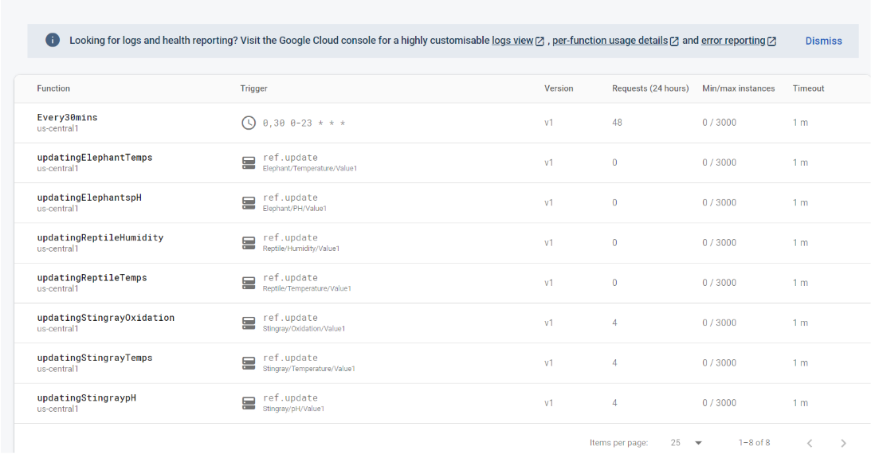
Firebase Cloud Functions
The cloud functions were a important part of this project because it took burden off the arduino microcontrollers which provides us with more battery life since it has to compute less things. At first, we had the microcontroller insert and shift data around in the real time database. We measured this and used to take about 3 minutes for the arduino to insert and shift the data correctly in the database. This is mainly due to the fact that it had to send 48 read requests and 48 write requests to the database for each sensor. We then employed cloud functions into our project and saw that the same task now takes 10-15 seconds.
Fig. 9: Cloud Functions
Notes:
Start reading this after first paragraph.
Fig. 9. demonstrates the cloud functions, which are written in javascript, and most of the cloud functions are update functions and each sensor for each animal has its own cloud function.
These update functions execute when data is inserted into the respective sensors path in the database.
Once data is inserted, the cloud function shifts data.
The shifting can be thought of as a First in First out (FIFO) data structure where inserting a element will push an element into the front of a queue or list.
Once done, pass it to Dominic

Slide 12
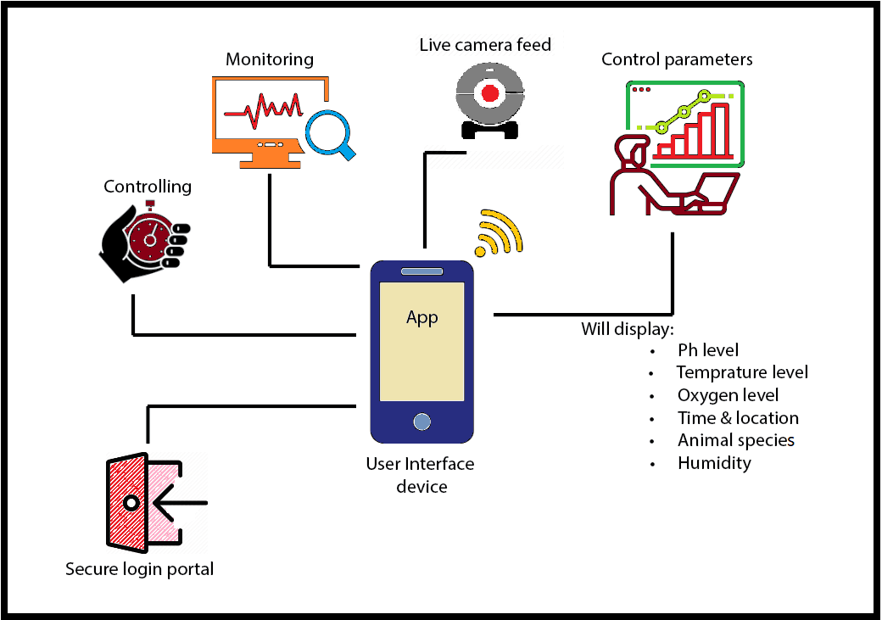
Designing User Interface
The Fig. 9: User interface block diagram is created to help us visualize specific components of our user interface module. Some of these modules are the Secure login portal, controlling, monitoring, live camera feed, and control parameters hub.
Login portal: User will log in using the login portal into a specific account to keep track of who made changes.
Cloud: Data from sensors comes from the database in the cloud.
Display: We will display the current data and also allow the user to see some of the past data in the form of a graph.
Camera feed: We will allow the user to see the animal through the app using the camera module which will track the animal.
Control parameters: We will keep track if any of the parameters reach a critical level, such as temperature which can be adjusted by a thermostat controlled by our microcontroller.
Fig. 9: User interface

Slide 13
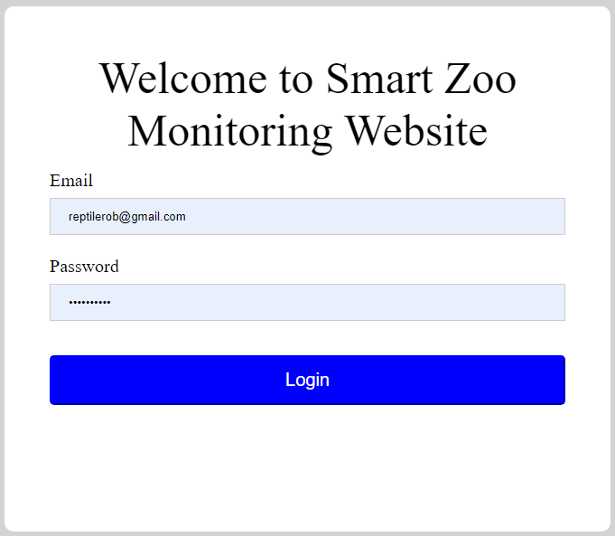
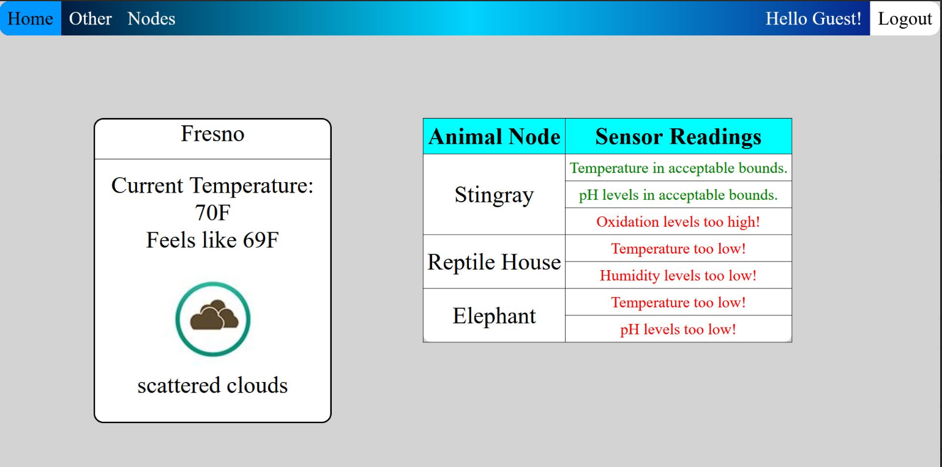
User Interface Login Page
Homepage
The user authentication page was made using firebase authentication, allowing us to control who views the website and ensure that only authorized users are able to view and change the designated values for what the zoo animal parameters should be
A homepage was implemented so that upon logging in, users would be able to see the current status for all the different animals at a quick glance. While this does not give an in-depth view of the actual values that are being collected on the sensors, it is a good indicator of how the animals are doing.
Fig. 11: Home Page
Fig. 10: Login Page

Slide 14
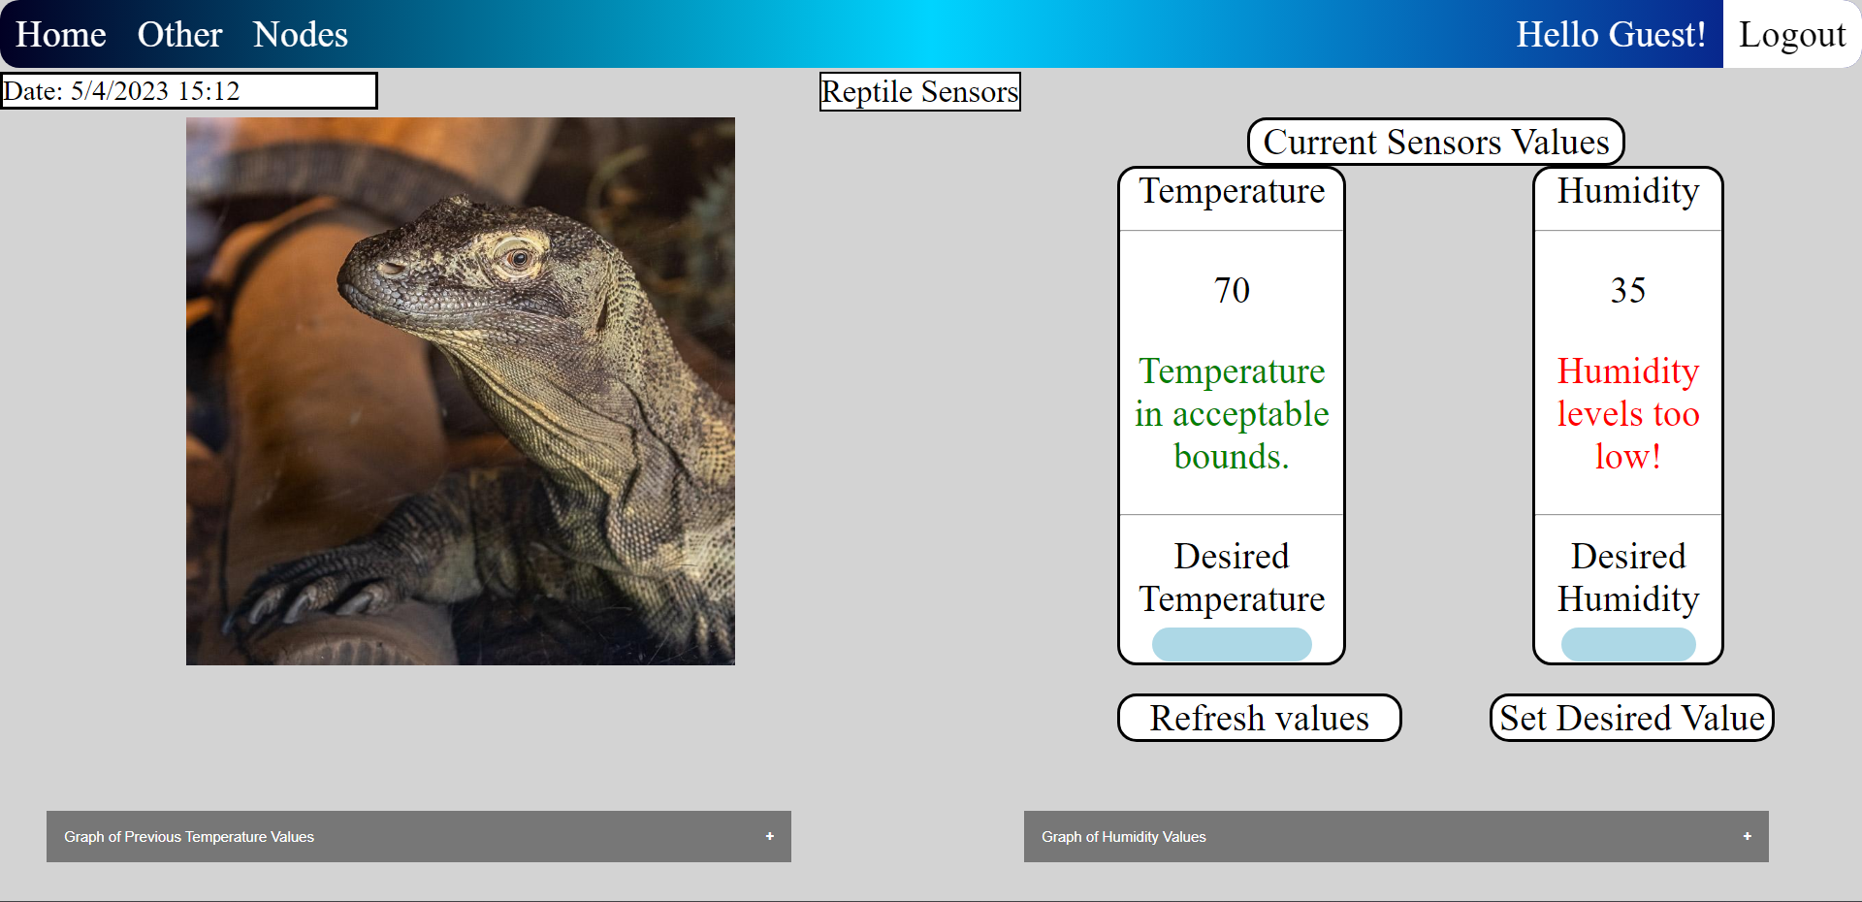
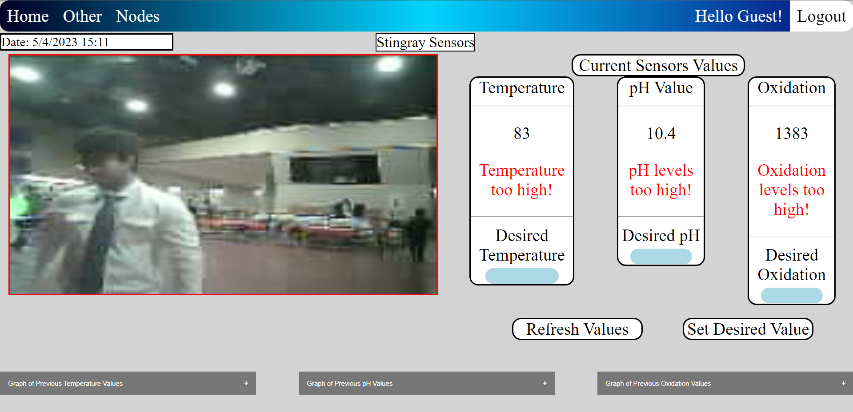
Animal web pages: Stingray
Animal web pages: Reptile
Features: Sensor readings panel
Temperature (F)
pH Value (0-14)
Oxidation (V)
Camera feed
Refresh values button
Set desired values
24 hour graph log for sensor readings
Current time/date
Fig. 13: Reptile Page
Features: Sensor readings panel
Temperature (F)
Humidity (%)
Refresh values button
Set desired values
24 hour graph log for sensor readings
Current time/date
Fig. 12: Stingray Page
Notes:
Read this first
With the project focusing on three different animal groups, three different web pages were made that could be accessed from the website’s navigation bar. Each of the pages hold the sensors that are specific to their animal

Slide 15
Quantitative Analysis
Introduce our findings for quantitative analysis conducted
Power consumption
Delays
Measurement units
Power consumption: The power required for our solar module is as follows: Voltage: 5-20V | Current drawn: 50-100mA | Power: 1.2W
Expected battery life (Without solar) : 70 hours
Battery charging time with solar: 17.5 - 20 hours of sunlight
Important note: If there is less sunlight than the ideal, the system will be powered by the battery. If there is more sunlight than ideal, the potentiometer should be adjusted so that the output voltage of the solar charge module is what we want it to be.
Total response time of hardware and updating sensor values: The code is programmed in a way to update sensor readings in order of, first ORP, then pH, and finally Temperature. The total delay in entire system is about 5-10 seconds, depending on the internet speed.
However, actuator delay is around 1-2 seconds. Meaning, once user inputs a desired temperature value, it will take about 1-2 seconds to turn on actuator power relay.
Camera module performance is not that great, the reason for that is because we are sending individual image frames, roughly 5 frames per second to firebase and storing it there, then website is pulling the data from cloud to web page and displaying it. Solution: Using a local webserver to be able to stream video through camera, this is the only way.
Most of our data is sensor readings which are integers
We store the binary ASCII of the camera image as a string
We store about 16 – 17 KB at any given time, but are able to store up to 1GB on the Firebase Database for free

Slide 16
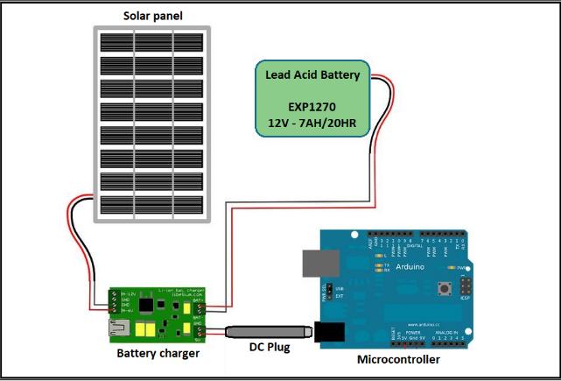
Solar Module Analysis
Introduce the solar design
Fig. 15: IoT Test model
Fig. 14: Solar module
Fig. 14 given above, is the prototype of the solar module system that we are currently using. Our power system consists of three main components which are a solar panel, a sealed lead acid battery, and a solar charge module. The solar panel inputs voltage/current to the solar charge module, and the solar charge module then outputs a fixed voltage/current to the battery to charge it. This fixed voltage/current can be adjusted with a potentiometer attached to the solar charge module. We then connected the solar panel and system load in parallel with our battery. This allows the solar panel to charge the battery and power the system depending on the power that the solar panel is producing.

Slide 17
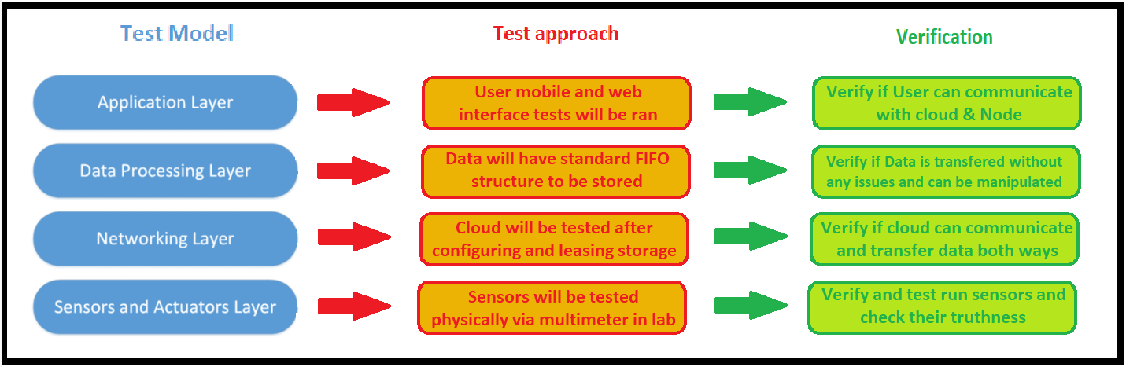
Test Plan
Introduce our approach for tests
Introduce our approach for verifications
Our test plan will have four total major parts and several minor parts that will be needed to be successful throughout our test runs. Fig. 15. indicates the big picture of what those major and minor tasks look like.
As shown on Fig. 15, test model is created to help us visualize the basics of the test model and verification protocols that our team is going to follow. This model is generated by using our IoT model from our Standards section of this report. Our IoT layers will have their own individual-specific test approach and verification protocol.
Fig. 15: IoT Test model

Slide 18
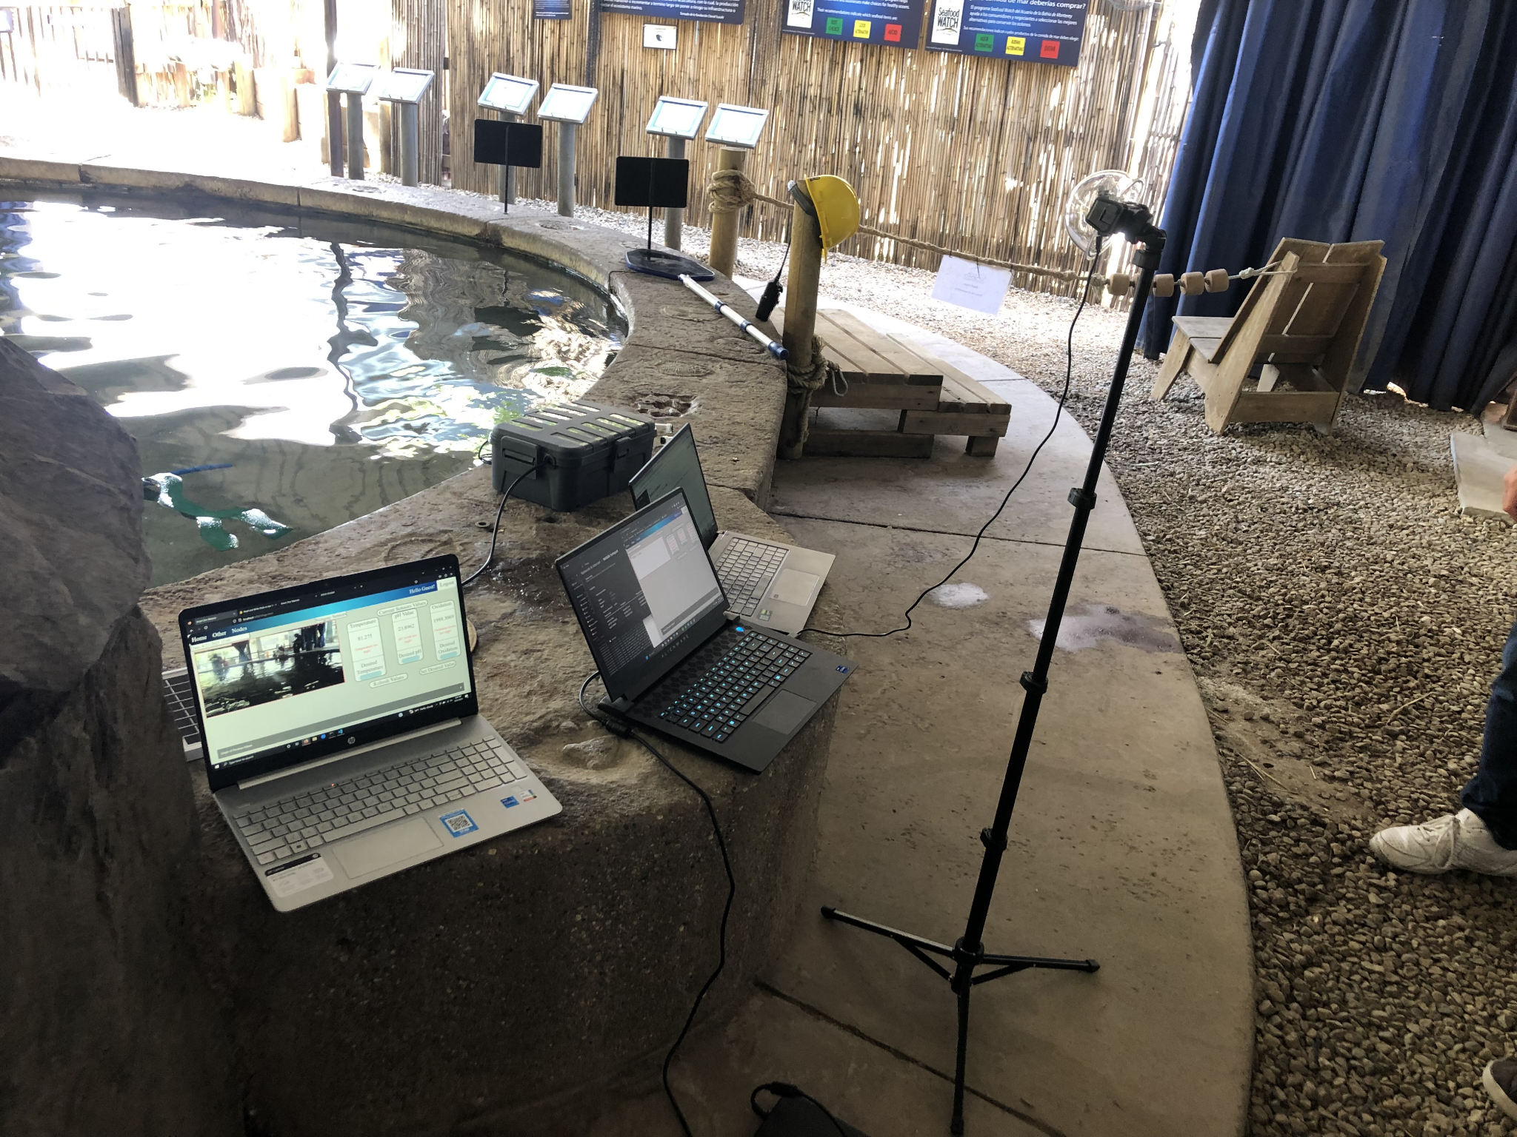
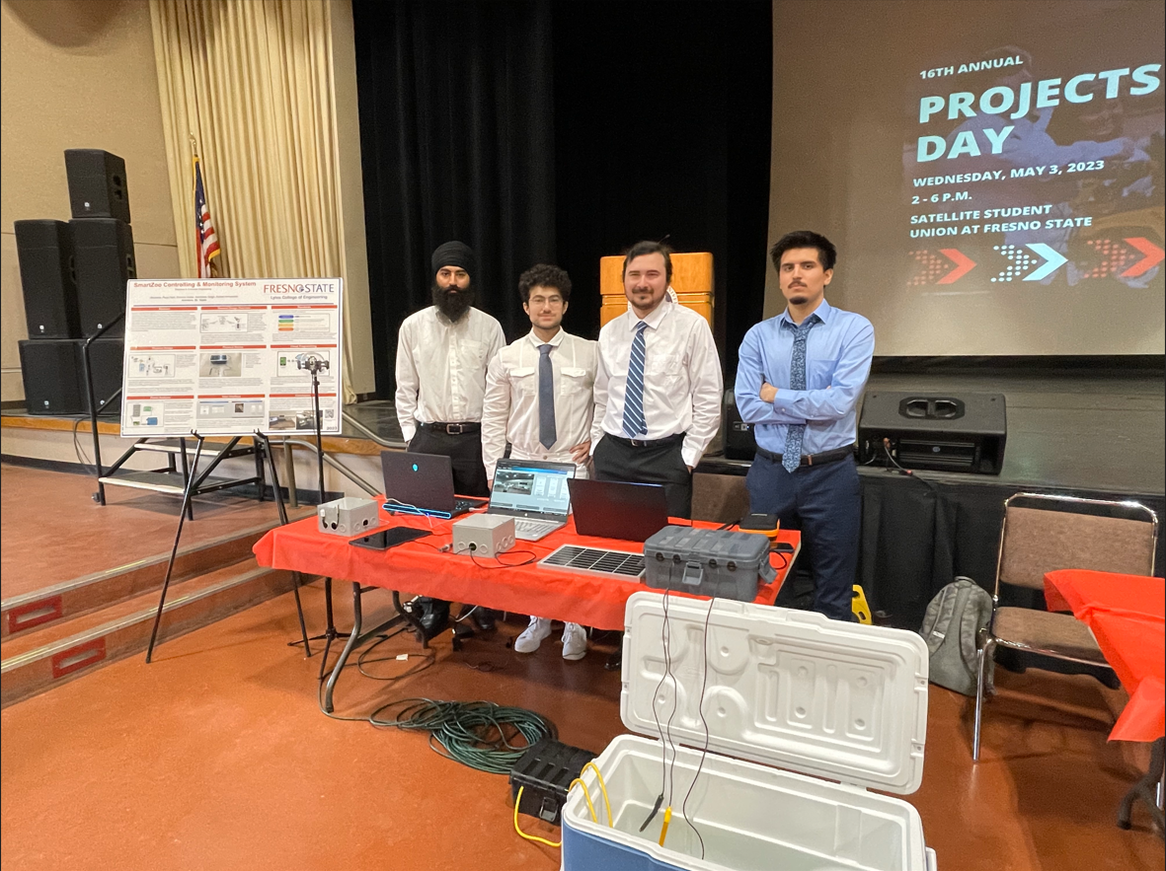
Experiment at Zoo
The figure below Fig. 16. displays our exhibit visit at Fresno Chaffee Zoo. Our group has brought the entire stingray module to the zoo and ran several test runs by the Stingray water tank. The temperature, pH, and Oxidations level shown at our website were accurate with the ones Zoo measured at the backstage.
Projects Day
The figure below Fig. 17. is a snapshot of the our projects day station on May 3rd. We have successfully presented our project to our faculty and other visitors. We each had individual roles that helped us navigate the process of presentation better.
Fig. 16: Zoo experiment
Fig. 17: Projects day experiment

Slide 19
Conclusion: End Product
As we come to the end of this project, we can look back with satisfaction at what we have achieved. By utilizing cutting-edge technologies such as embedded systems, cloud-based programming, and a software-based user interface, we were able to monitor, collect, and store data pertaining to the animal groups of stingrays, elephants, and reptiles.
Overall, this project was a success, and we hope it will contribute to the ongoing efforts towards animal conservation and welfare.

Slide 20
Thank you for your time!
Any questions?

